Slide 1
Crowd Wisdom and Player Evaluation
Identifying biases in traditional scouting methods
@CROWDSCOUTSPRTS
COLE92ANDERSON@GMAIL.COM
WWW.CROWDSCOUTSPORTS.COM

Slide 2
OVERVIEW
What is Crowd Scouting?
Combining Eye-Test & Objective Data
Exploring Biases

Slide 3
WHAT IS CROWD SCOUTING?

Slide 4
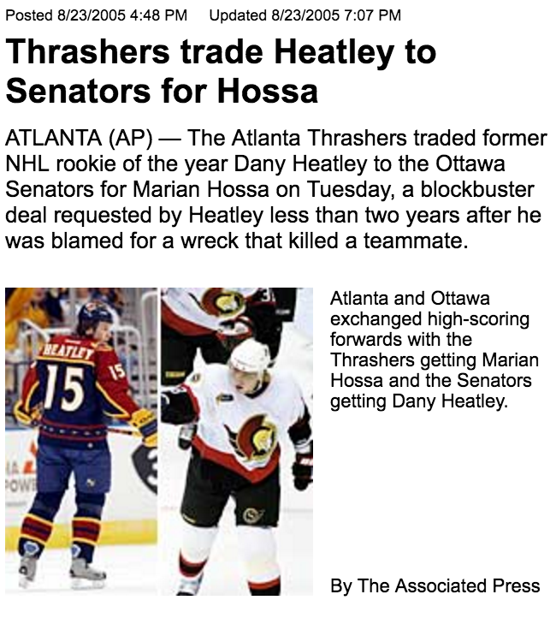
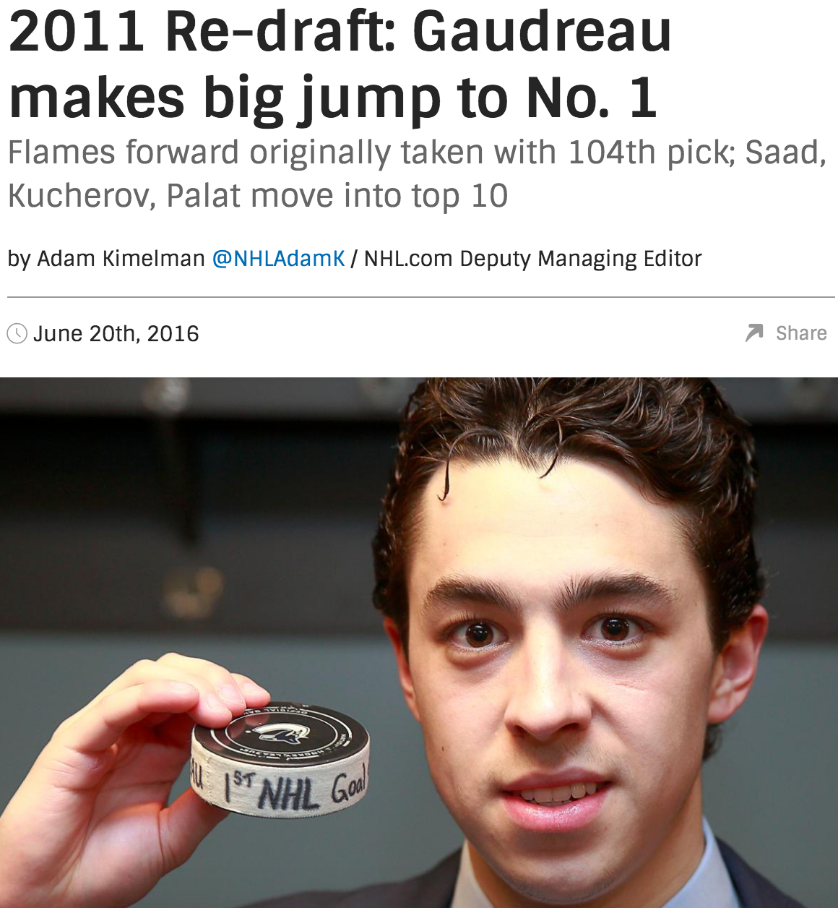
CROWD WISDOM
ARE SOME PEOPLE CONSISTENTLY AHEAD OF THE CURVE?

Slide 5



MONEYPUCK
MARKET DYNAMICS
PLAYER VALUATION MARKET UNQUANTIFIED, TOUGH TO INFER
WHERE DO EYE-TEST & ANALYTICS ALIGN? WHERE DO THEY DEVIATE?
BIASES IN EITHER MARKET

Slide 6
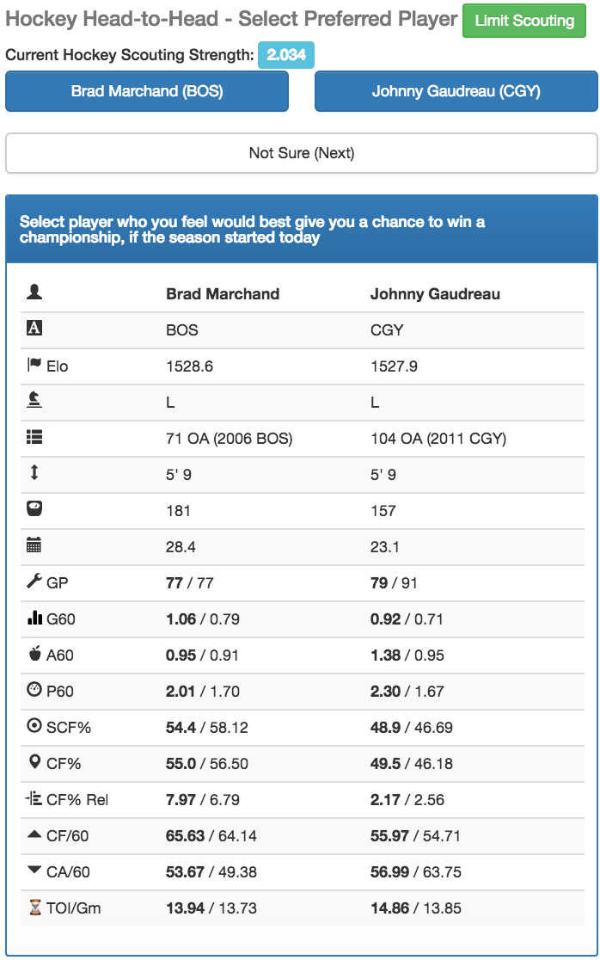
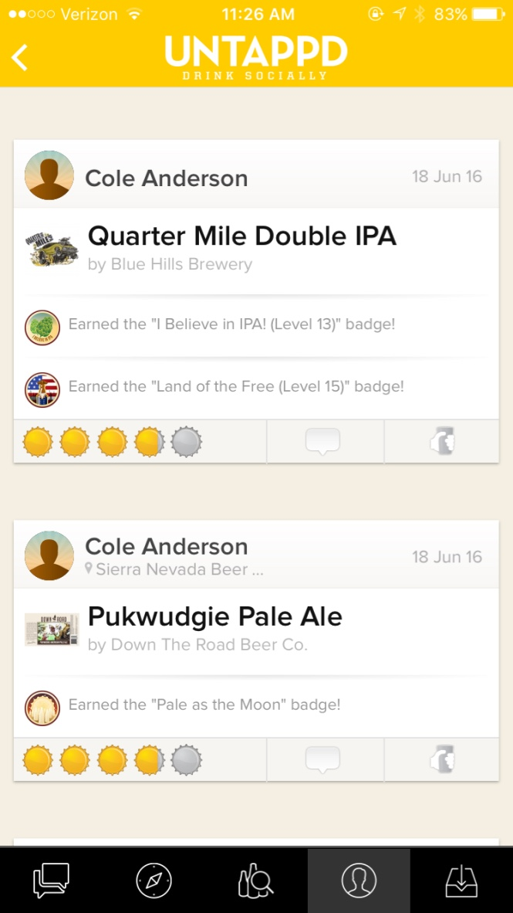
PLAYER RATING
TOUGH DECSIONS FROM A DIVERSE CROWD

Slide 7
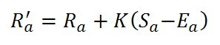
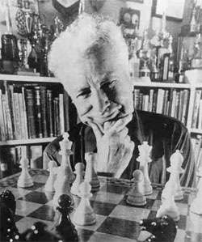
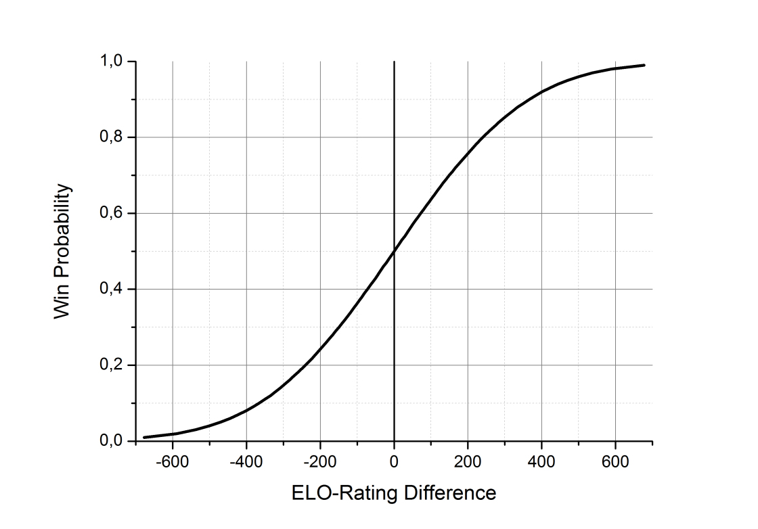

ELO FORMULA
ALL ABOUT THE PRIORS

Slide 8
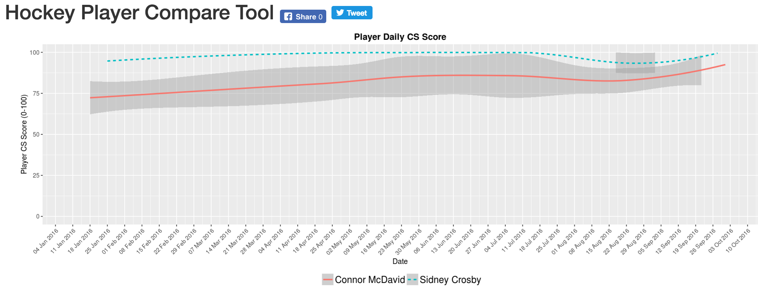
ELO IN ACTION
CHANGING OF THE GUARD?

Slide 9
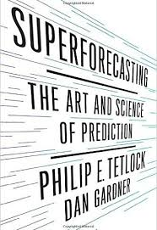
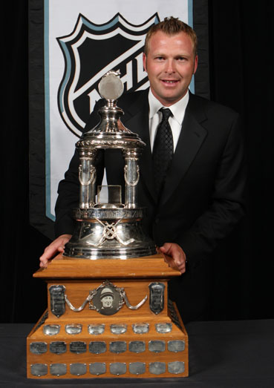
SUPERSCOUTING OR NO?
TRACK WHAT PEOPLE CHOOSE AND JUDGE

Slide 10
COMBINING EYE-TEST & OBJECTIVE DATA

Slide 11



MODELING THE EYE-TEST
ASKING (STUMBLING UPON) THE RIGHT QUESTIONS
TARGET
SPLIT SEASON STATISTICS
CARET

Slide 12
GENERALIZED LINEAR MODEL
GENERALLY EVERYBODY IS OKAY

Slide 13
RANDOM FOREST MODEL
NOT SO RANDOM

Slide 14
RESIDUAL COMPARE
GENERALLY AGREE

Slide 15
INTRASEASON PREDICTIONS

Slide 16
BACK-TEST AND BENCHMARK
MODEL PREDICTION VERSUS GOALS VERSUS THRESHOLD THRESHOLD

Slide 17
EXPLORING BIASES

Slide 18
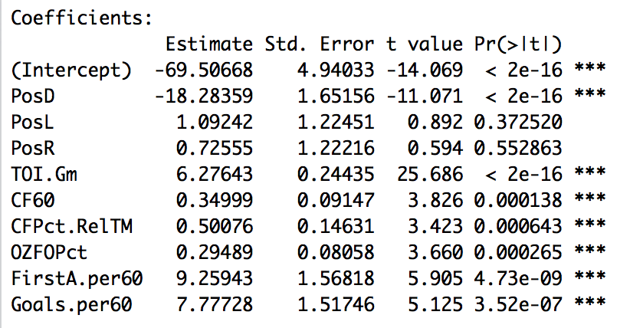
EXPLANATORY FEATURES
OFFENSIVE IN NATURE
GLM FEATURES
RANDOM FOREST FEATURES

Slide 19


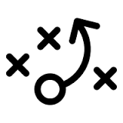
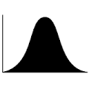
GETTING DEFENSIVE
DISCUSSION TOPICS
SHOT GENERATED IS VIEWABLE, SHOT PREVENTED IS NOT
APPEAL OF RESULTS BASED DEFENSIVE METRICS
COACHING IMPLICATIONS (NOT A CROWD ISSUE)
DISTRIBUTION OF OFFENSIVE & DEFENSIVE TALENT

Slide 20




FUTURE AT @CROWDSCOUTSPRTS
DISCUSSION TOPICS
ALTERNATIVE RESULT-BASED MEASUREMENTS
STAY SKEPTICAL OF DATA
CROWDSCOUT DATA EVOLVING
USE MACHINE LEARNING METHODS TO JUDGE SELECTIONS

